Slide 1
HMPPS Workforce Statistics RAP
Chloe Pugh
DASHRAS
January 2020
https://github.com/moj-analytical-services/coffee-and-coding-public/

Slide 2
Contents
Introduction to Reproducible Analytical Pipelines (RAP) for statistical publications
Overview of the HMPPS Workforce Statistics RAP project
Some of my lessons learned and recommendations
Interactive session – using the RAP approach to make our own mini bulletin

Slide 3
Introduction to RAP

Slide 4

The basics
Reproducible Analytical Pipelines (RAP) can be used to automate some or all steps of the production of statistical reports. In general they involve:
Writing code to automate the data processing
Using something like R Markdown to create the report itself
Using Github to store and version control the code
The code can then be used again and again to create new publications.
Notes:
Each RAP will be unique to each report, but share some common features.

Slide 5
Benefits of RAP
Saving time in the long run, after an initial time investment
Allows more time for additional analysis and responding to FOIs
Reducing repetitive and laborious manual tasks
E.g. copying and pasting
Reduces risk of human error
Reproducibility means easier auditing
This means specific publications can be re-created months or years later if necessary
Learning new skills
Working on a RAP project can be challenging but very rewarding
Reduced risk of loss of knowledge
A RAP project should be easy to hand over to someone else

Slide 6
Suitability for RAP
Things to consider (not exhaustive!)…
Do you have time?
If the publication is a one-off then building a RAP may not be worth the time investment
The time saved producing future publications should be greater than the amount of time you spend on the RAP
Do the source data come in a machine readable and consistent format?
E.g. consistent file types and column names
Does the publication format remain fairly constant?
E.g. the layout, charts, figures, text, and accompanying tables
✅
✅
✅

Slide 7
HMPPS Workforce Statistics
RAP project

Slide 8
There are two main parts of the HMPPS Workforce Statistics publication:
The bulletin
A workbook of Excel tables

Slide 9
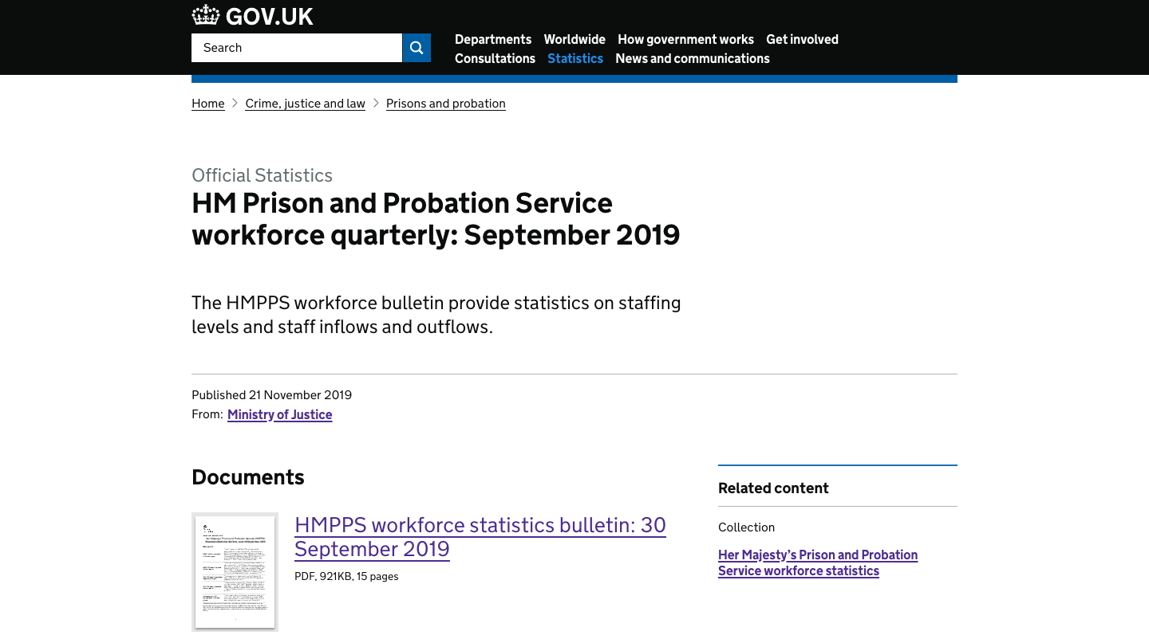
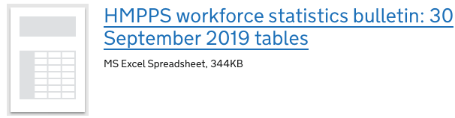

Slide 10
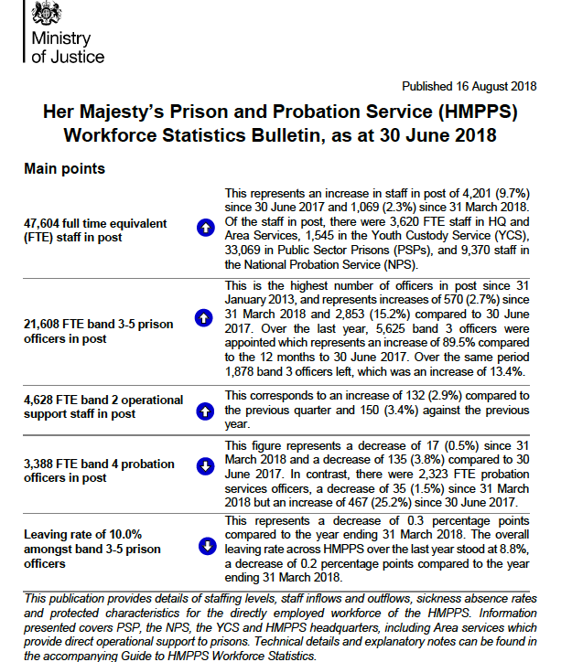
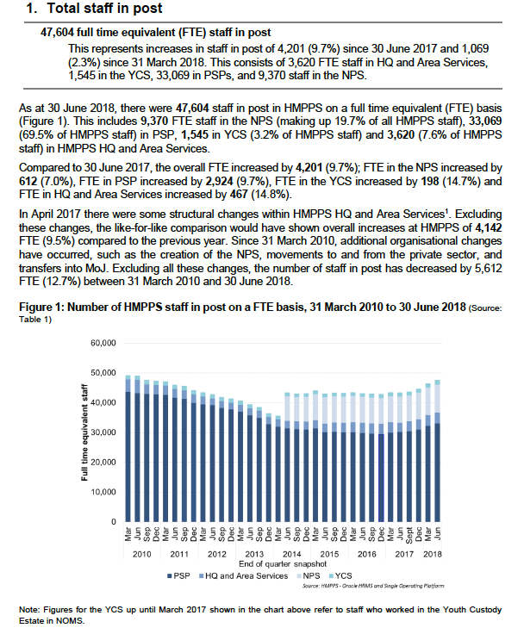
The original version of bulletin

Slide 11
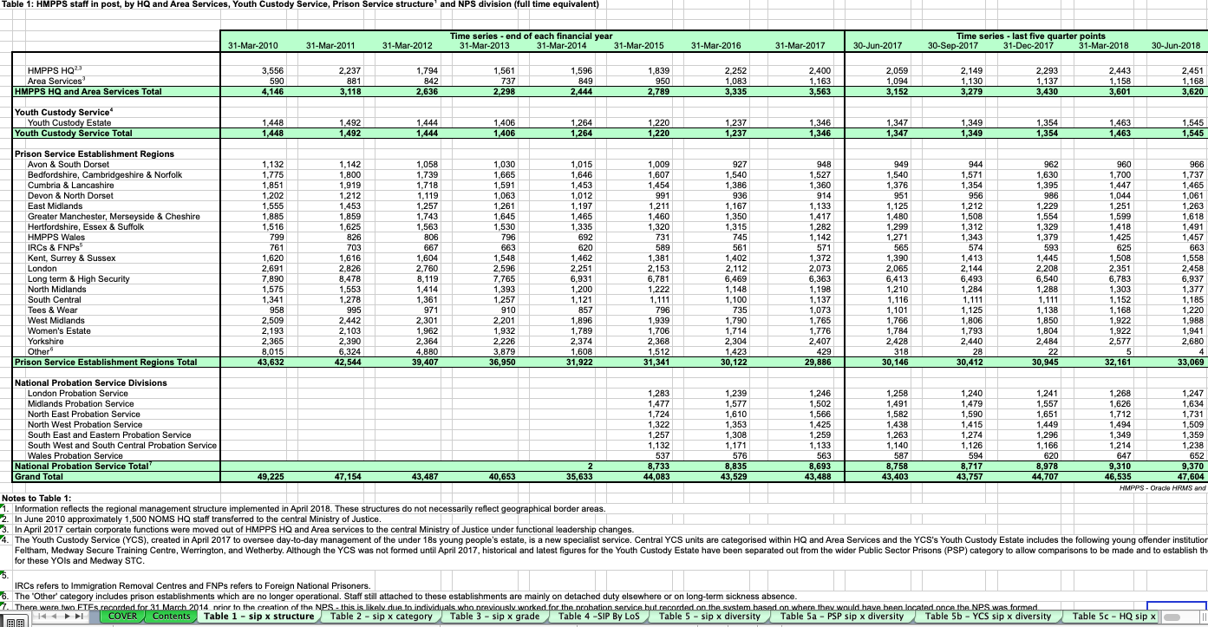
The original version of the Excel tables

Slide 12
Workflow
The work on this project was split into three parts:
Writing code to process the raw data (which is stored in an s3 bucket on the Analytical Platform) in order to recreate the figures in the Excel tables and bulletin
Automating the production of the bulletin
Automating the production of the Excel workbook
All parts of this project were managed on Github:
https://github.com/moj-analytical-services/hmpps-wfs-rap
Notes:
The bulk of the work was spent on part 1, and this was the part we needed to complete first.

Slide 13
Part 1: Data processing
The task:
There were 26 summary tables that needed recreating
Our approach:
We started off trying to reproduce the figures from a previous publication
Our Grade 7 wrote the first R script to recreate a table – this acted like a template, and we created the rest based on that template
Each of us would work on one table at a time, writing an R script dedicated to creating that table and saving that table as a csv file
We made use of user-defined functions to keep code consistent throughout all of the R scripts
Notes:
The bulk of the work was spent on part 1, and this was the part we needed to complete first.

Slide 14
Part 1: Data processing
We worked collaboratively using a git workflow:
We created a new git branch for each of the table-creating scripts
When a script was finished we opened up a pull request for that git branch
We assigned another team member as a reviewer, then they would QA the code
Once any improvements had been completed, the reviewer would approve the pull request and merge with the master branch
The further reading section has links to more information on git.

Slide 15


Part 2: Creating the bulletin
The bulletin is usually around 13 pages long, and includes lots of figures and charts that need updating every quarter.
We split the code for this part between 3 scripts:
An R script that reads in the processed data, derives the figures for the bulletin, and stores those figures as variables ready to be used
An R script that produces the charts for the bulletin
An Rmd (R Markdown) script that puts together the bulletin itself, bringing in the figures and charts from the other two scripts
We also included a copy of the Rmd file where manual changes could be made without needing to edit the main version.
Figures
Charts
Bulletin
Notes:
(We also included a copy of the Rmd file where manual changes could be made without needing to edit the main version) For example, if a figure had changed substantially compared to previous quarters then this could be emphasised in the ‘manual changes’ version, and text added with extra detail

Slide 16
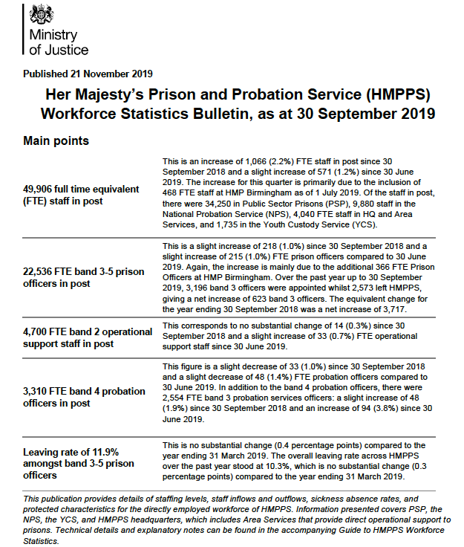
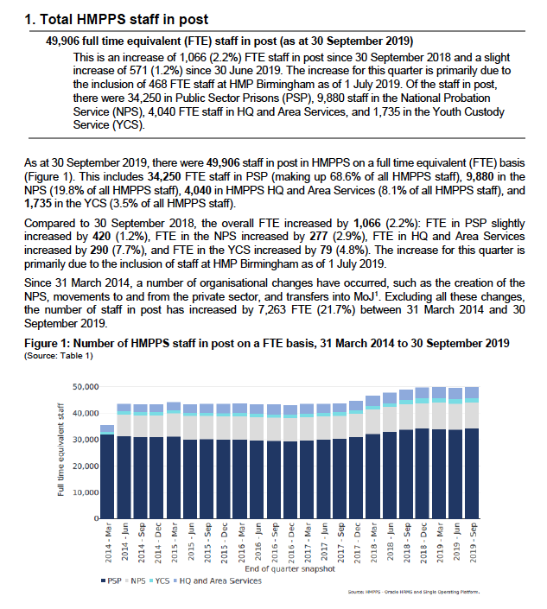
Part 2: The new bulletin

Slide 17
Part 3: Creating the Excel workbook
We made use of the xltabr R package to help put together the Excel workbook.
The R script first reads in a template Excel workbook
Then it adds the tables one-by-one to the template workbook, each in a new Excel sheet
Custom styling is added using the openxlsx R package
When finished it saves the Excel workbook to a secure folder on s3
The further reading section has links to more information on xltabr.

Slide 18
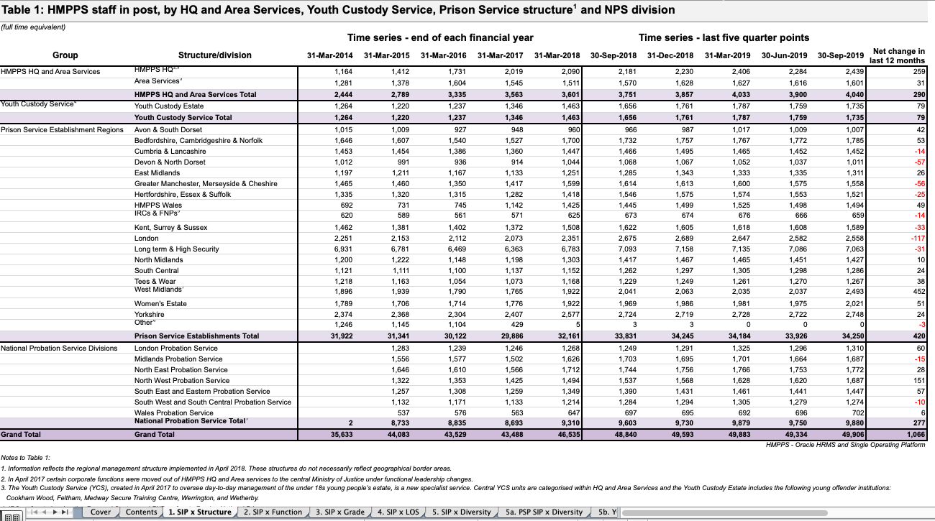
Part 3: The new Excel workbook

Slide 19
Bringing everything together
A master script to run everything in one go
To make updating the publication as easy as possible, we created a master script to run all of the other scripts, one after the other
A control script to update variables
We also have a control script containing variables that might need updating in the future
This is the only script that needs editing in order to create a new publication
Comprehensive documentation
Includes instructions on how to run the RAP code for a new quarter
Package management
We used Conda to record which packages and package versions the code requires

Slide 20
Lessons learned and recommendations

Slide 21
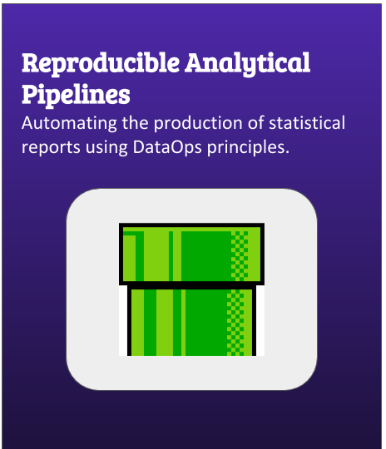

My lessons learned and recommendations
Check out the excellent RAP companion produced by GDS
Linked in the Further Reading section at the end
Github is your friend
Indispensible for working collaboratively
Version control means you can always go back if something goes wrong
Try to keep each commit focused on a particular addition/change, to make the changes easier to keep track of

Slide 22
My lessons learned and recommendations
Be mindful of keeping code organised right from the start
Prevents code becoming too long and difficult to follow later on
Use functions to avoid repetition
Avoid putting too much into one script – splitting into multiple scripts, each with a well-defined purpose, can make code easier to follow
Formatted Excel tables can be difficult to work with
Consider using a package like xltabr to maintain a consistent format
Thorough documentation makes life easier

Slide 23
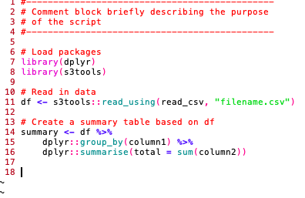
Documentation – code
Well documented code makes QA and handovers much easier.
At the top of each script include a comment-block with a brief description of the purpose of the script
Include comments throughout the code, describing the intention of each step so that someone else can understand its purpose (avoid stating the obvious though!)

Slide 24
Documentation – README
Include a README file in the Github repository so someone can read about the project without having to look through all the code.
Description of the project and its purpose
Instructions so that anyone can run the code
Details of any manual changes that might need making (e.g. more complicated redactions)
Details of where the datasets are stored (e.g. s3 bucket), where new data should be added, descriptions of all the raw datasets required along with expected file names
Overview of the code structure and descriptions of all of the scripts

Slide 25
Interactive session

Slide 26
Interactive session
Now it’s time to have a go at our own mini-RAP project!
First download the following files provided for this session from https://github.com/moj-analytical-services/coffee-and-coding-public/tree/master/2020-01-14 HMPPS Workforce Statistics RAP:
controls.R – this script contains the sorts of variables that might need updating for a new publication
prep_data.R – this script loads the data and generates some figures for the report
create_charts.R – this script generates the charts for the report
report_exercise.Rmd – this is the R Markdown script that generates the report itself
moj_logo.png – this is the MoJ logo, which gets used by the Markdown script

Slide 27
Interactive session
Now load and have a look at the example report:
Open up RStudio
Upload the R scripts and png file to RStudio
Open up the R/Rmd scripts
Go to report_exercises.Rmd, and click ‘knit’ at the top of the window – this generates a pdf of the report

Slide 28
Exercises
Fill in the missing variable text (denoted by …) in section 2. You can find the text pre-defined in the variable max_windspeed_yearly_text in prep_data.R. Hint: Find where the variable text in the first paragraph of section 1 is added in report_exercise.Rmd, and use a similar approach to add the missing text in section 2.
Edit report_exercise.Rmd to add a chart to section 2. You can find a pre-made chart for Fig. 2 in the script create_charts.R. Hint: Find where the Fig. 1 chart is added in report_exercise.Rmd, and use a similar approach to add the second chart.
There is a mistake in the contact information on the last page. Can you find and correct it in report_exercise.Rmd?
Once you’ve made changes to report_exercise.Rmd, click ‘Knit’ again to produce a new version of the report.

Slide 29
Further reading
RAP companion:
https://ukgovdatascience.github.io/rap_companion/
DASD Introduction to R training:
https://github.com/moj-analytical-services/IntroRTraining
Basic introduction to Github and Git:
https://guides.github.com/activities/hello-world/
DASD Git training:
https://github.com/moj-analytical-services/git-training-class
A template .gitignore to help prevent accidental commit of sensitive data to Github:
https://github.com/ukgovdatascience/dotfiles

Slide 30
Further reading
DASD R Markdown training:
https://github.com/moj-analytical-services/rmarkdown_training
DASD Writing functions in R training:
https://github.com/moj-analytical-services/writing_functions_in_r
Conda package management on the Analytical Platform guidance:
https://user-guidance.services.alpha.mojanalytics.xyz/appendix/conda/#environment-management
xltabr R package:
https://github.com/moj-analytical-services/xltabr
https://github.com/moj-analytical-services/xltabr_training
Package with some useful functions for RAP:
https://github.com/moj-analytical-services/mojrap

